Slide 1

Water and Water system: why should we care?
Enl!ghten
Kitsap Community Forum
October 18, 2019

Slide 2

Water = Life
Earth Day = Every Day

Slide 3
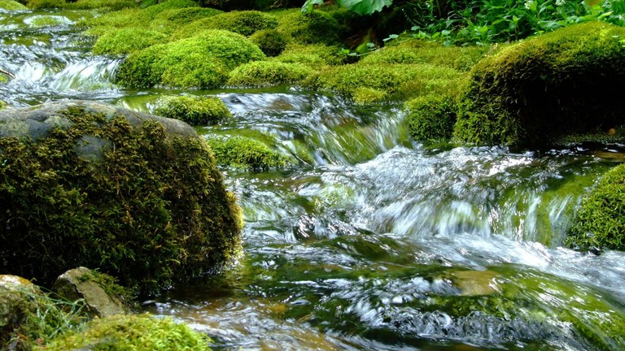
WE DEPEND ON WATER IN KITSAP
As homeowners – for drinking, washing, flushing
In our community for water quality
For recreation
For protection from storms
To protect our environment

Slide 4
League of Women Voters
League of Women Voters – Mission
“Empowering Voters. Defending Democracy.”
How we do this
Voter Education
Voter registration
Candidate Forums
Civic Involvement and Education
Why a Water Committee was formed

Slide 5
In the Beginning
League members had interests and concerns
Need to know the basics:
Drinking Water
Wastewater
Stormwater

Slide 6
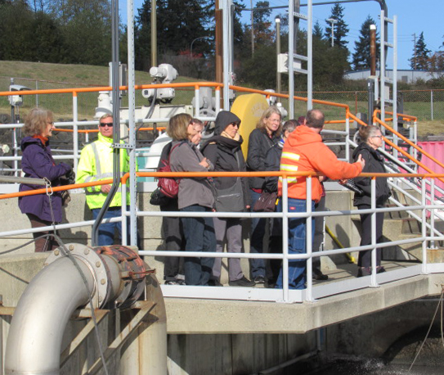
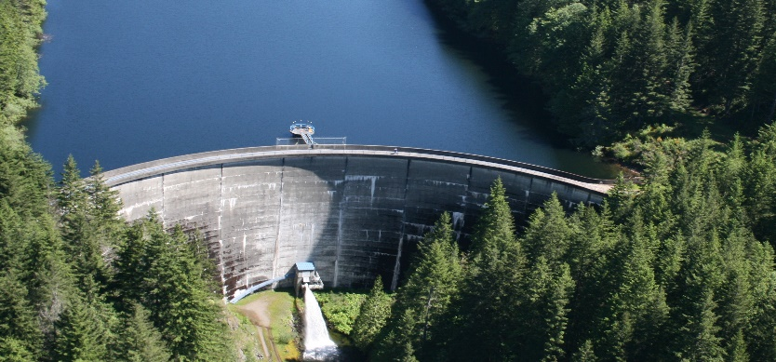
Field Trips/Meetings
Bremerton Watershed/Casad Dam
Bremerton Wastewater Treatment Plant
Green Stormwater Projects
Kitsap Public Utility District
Kitsap Public Health District

Slide 7
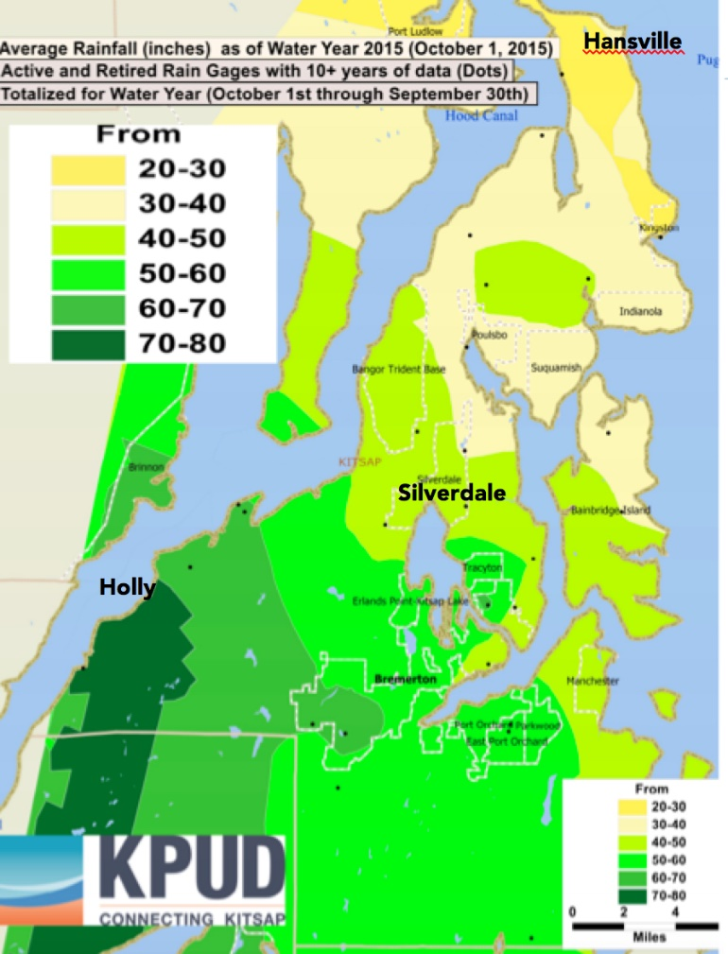
Goals of Effort
Identify the sources of Kitsap water
Understand how our water is kept clean and safe
Learn how to protect our water
Educate the public
Highlight responsibilities of
residents

Slide 8
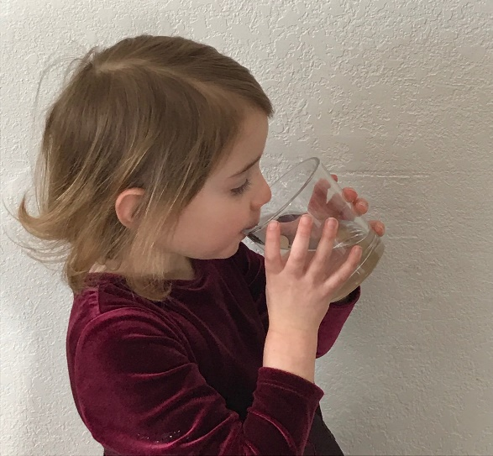
A Practical Guide to Kitsap Water
Created
Kitsap’s sources of water
Basic water systems
Resources and links to more information

Slide 9
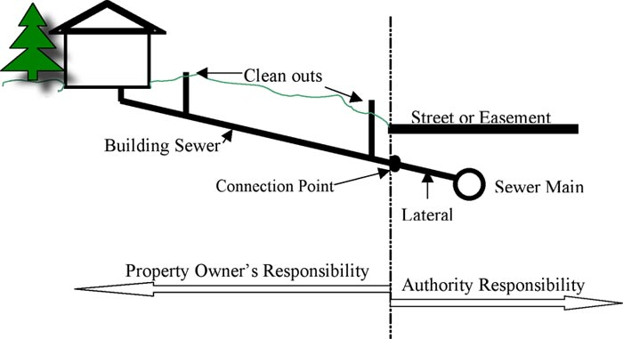
Our editorial approach to writing the Guide
Plain-spoken language
Question/Answer format
Educate about clean water practices

Slide 10

Our AHA! Moments
“All the water that will ever be on earth
is already here.”
Kitsap’s primary drinking water source:
RAIN!

Slide 11
Our AHA! Moments Drinking Water
Wells pump water to the surface from aquifers.
Approximately 215,000 people are served by large water systems
More than 43,000 people are served by unregulated small well systems.
Water testing is mostly voluntary.

Slide 12
Our AHA! Moments Wastewater
More than 50% of Kitsap wastewater is treated by septic systems
Septic system maintenance -- mostly voluntary

Slide 13
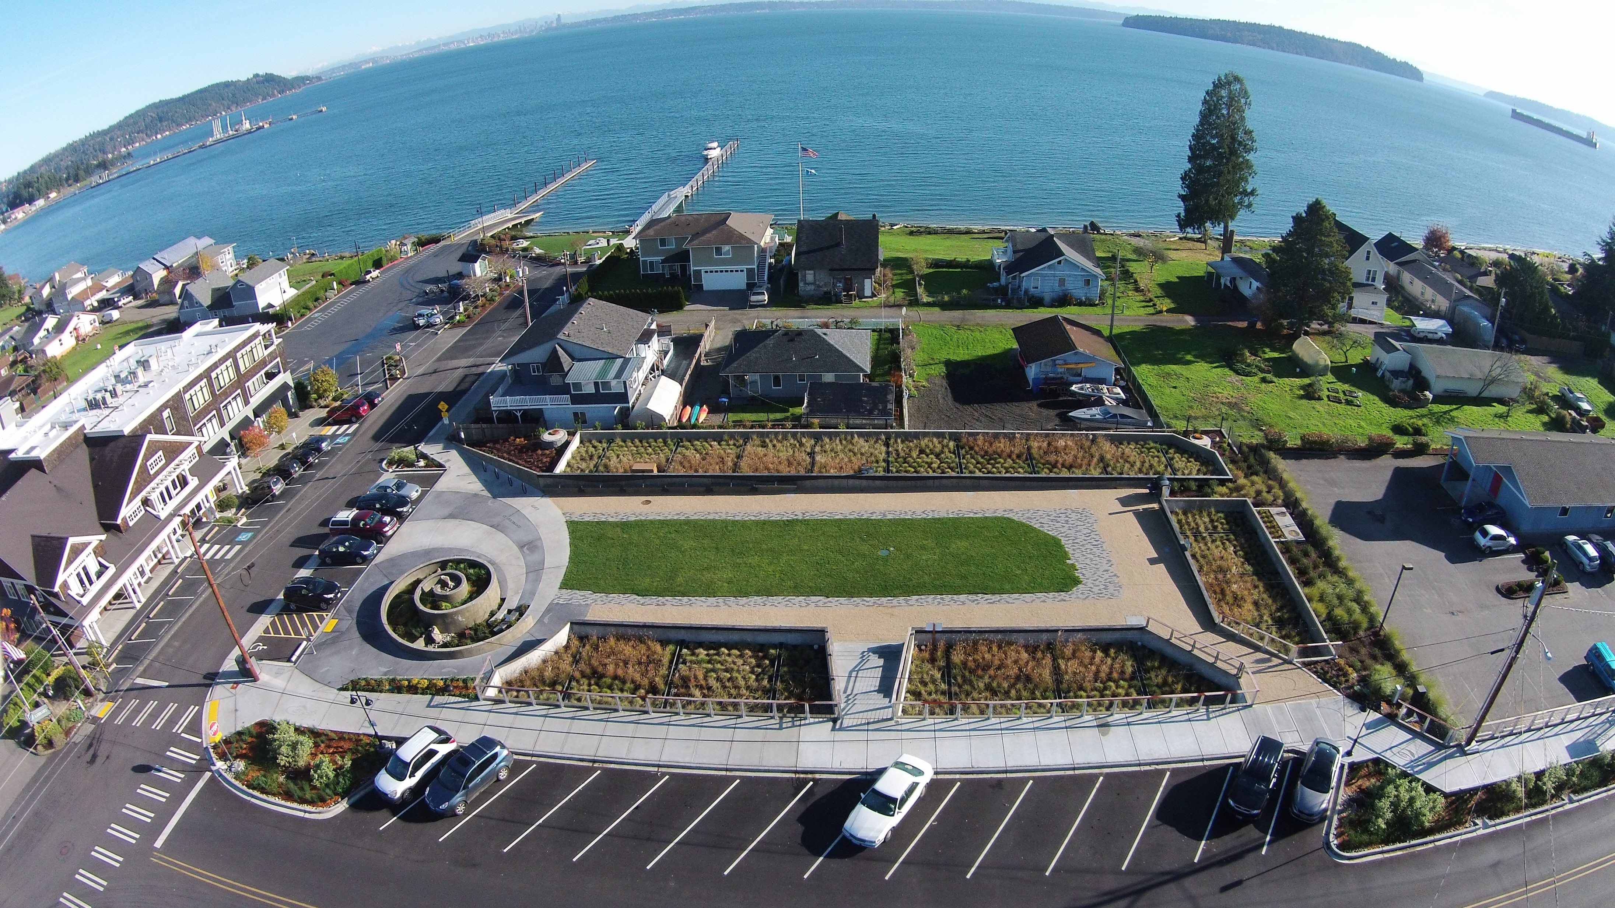
Our AHA! Moments Stormwater
Kitsap has amazing new stormwater infrastructure: Keyport, Silverdale, Manchester but problems remain due to development and climate change
Stormwater problems affecting private property are the responsibility of the property owner

Slide 14
Dollar Issue$
Aging Systems – Maintenance and replacement
Group B Wells – Inspection and oversight
Stormwater Infrastructure – Updating and new construction
Utilities make major financial and infrastructure decisions and investments.

Slide 15
Take-Aways
So far, Kitsap has plenty of good water available.
Individually and as a community, we must take responsibility for protecting our precious water.

Slide 16
Clean Water is a Group Effort!
It’s up to us to understand our water systems.
Knowledge drives good decision making.
Hope you will read and share the Guide.

Slide 17
Thank You!

